Slide 1
IELTS Speaking Test

Slide 2
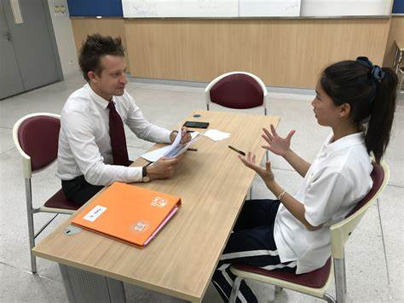
Parts 1 & 2
eye contact
polite and friendly
body language
no prepared speeches
tense
don't simply answer Yes or No
answer all of the questions fully

Slide 3
Describe an interesting place that you have visited as a tourist.
You should say:
where this place is
why you went there
what you did there
and explain why you thought this place was so interesting.

Slide 4
Part 2 Organising your answer
Take notes (1 min)
Start with an opening phrase
Make 1-2 sentences about each bullet point
Add details: one fact + one opinion (+ an example + a story)
Stay focused; don't go off-topic
Make 3-4 sentences about the last part of the question
Finish with a concluding phrase

Slide 5

Link your ideas
after that
because of this
but then
also
that's how
now
so maybe

Slide 6
Glossary: a place
expand our horizons // open our minds
broaden our knowledge of other cultures
We took a break from work and recharged our batteries on the beach.
get away from busy city life
get away from the hustle and bustle of city life
go on holiday // We went to...on a family holiday.
leisure facilities: karaoke bars/ lounge, sports centres
The local nightlife is fun and lively.

Slide 7
a popular holiday destination
tourist/ historical/ cultural/ natural attractions
a heritage site
... is still in good condition
It connects us to the past.
the tourist season
is always packed with people
Borough Market in central London is a paradise for food-lovers.
plan my itinerary well
travel guide // (tour guide)

Slide 8
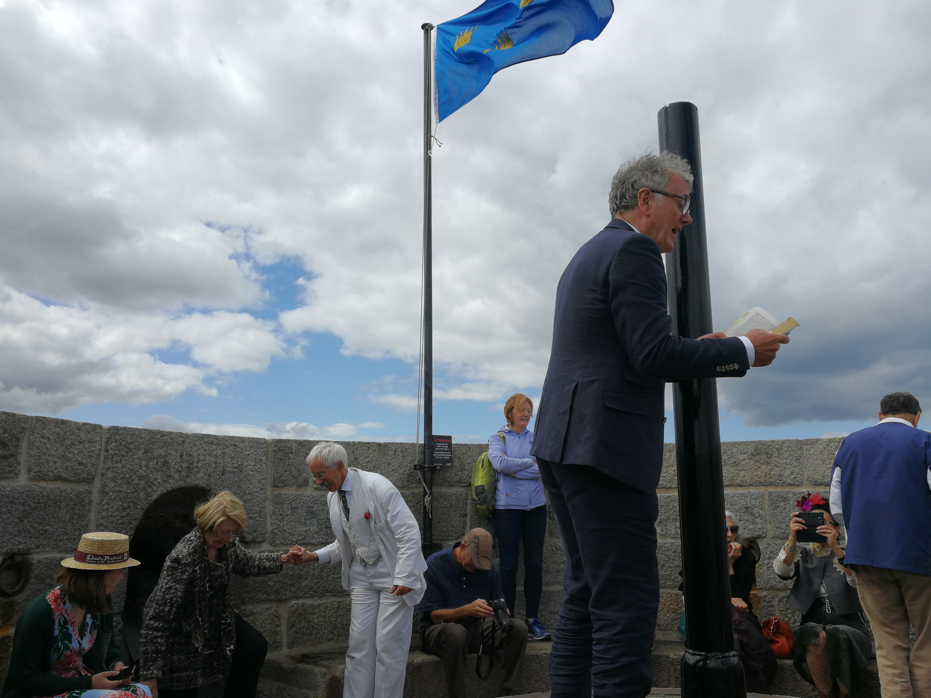
My budget is pretty small/ limited.
travel on a small budget
a memorable experience
explore the local culture and history
wander around
interact with the locals
exotic
one of the highlights of the trip
James Joyce Tower
June 16, 2018

Slide 9
The Eiffel Tower is a famous landmark in Paris.
It has a lot of character. // It lacks character.
It's well-designed/ well-decorated/ well laid-out.
The building dates back to the 18th century.
a lively city
provides reliable public transport
a fast-paced lifestyle
a sense of belonging to their neighbourhood
It suits all ages and interests.
suits my needs

Slide 10
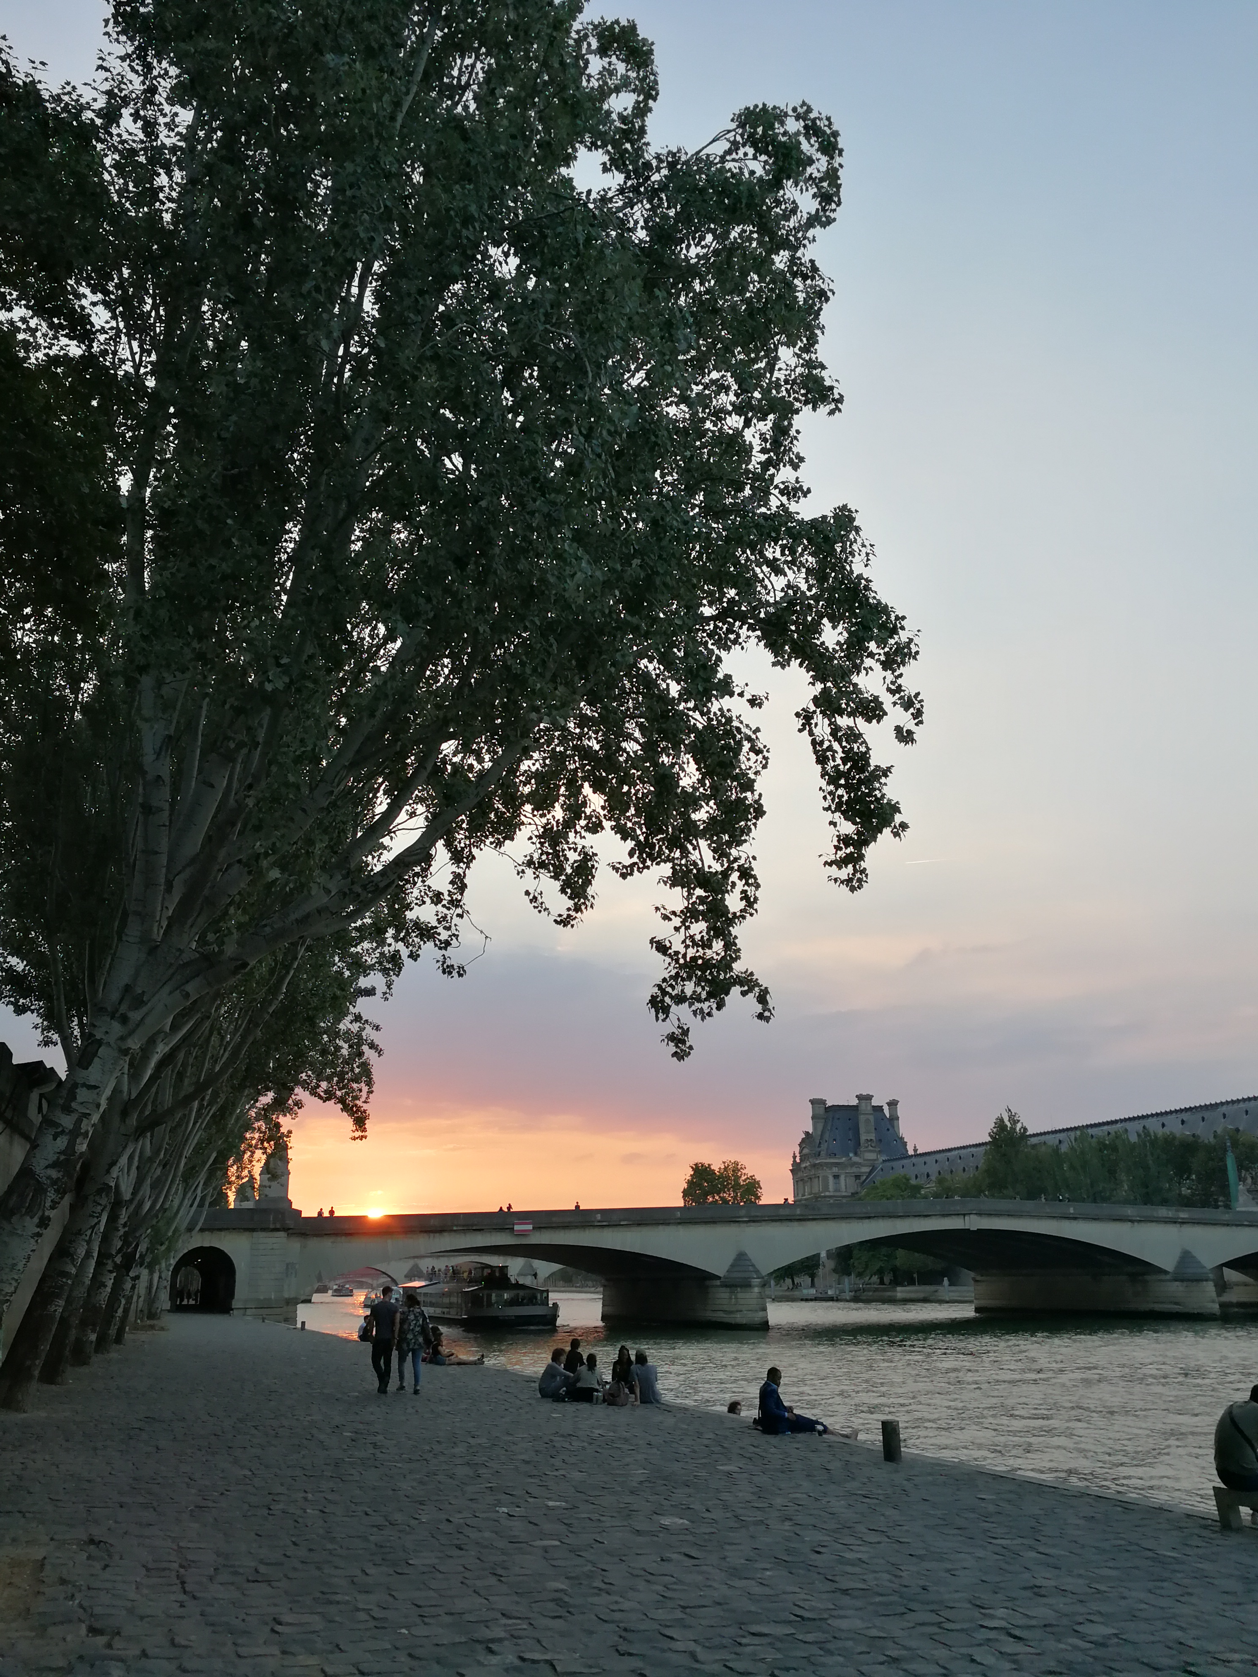
lawns and flowerbeds
looks like a picture postcard
is a perfect picnic spot
It's surrounded by...
garden paths
We need more green space in our cities.
enjoy the scenery / enjoy the natural beauty
The city looks so beautiful with the autumn foliage.
view the autumn foliage

Slide 11
If you run out of ideas, you can
look quickly at your notes
look at the question again (did you miss any details out?)
refer back to an earlier point in your talk and add more
keep talking and ask a question if you are not sure what to say
Lie/ make up an answer
Use someone else's ideas and make them about yourself.

Slide 12
Describe a person you like. (1 to 2 minutes)
You should say:
who the person is
what the person does
what is special about him/her
and explain why you like this person.

Slide 13
Glossary: a person
He is tall.
He is not as tall as me.
She is petite.
He is a little bit overweight.
He is lean.
She is slender.

Slide 14
kind
considerate
warm
funny
entertaining
fun
e.g. She's really fun to be with.
reliable
honest
straightforward
cheerful
positive
optimistic

Slide 15
My parents are in their 50s.
My friends are around my age.
hang out with my friends
sociable
They accept parcels for me when I'm not at home.
achieve success

Slide 16
Jay Chou
be concerned about him
He was kind of average-looking.
He started out as a songwriter.
released his first album
the album became an instant hit
blend a wide variety of music styles, such as R&B, hip-hop, and folk music
memorable

Slide 17
My mother
She's of average height and build.
She's caring and understanding.
colleagues
share her knowledge
has a good sense of humour
make her classes fun and interesting
cares about her students

Slide 18
has a smile on her face
takes good care of everyone
at bedtime
never forced her opinions on me
cooking skills
turn to her for good advice
I take after her

Slide 19
Part 3
answer all of the questions as fully as possible
expand on your answers as much as possible

Slide 20
Techniques
stating or explaining your own view
giving relevant examples
explaining how or why something happens
saying what would, could, should or might happen
suggesting a solution to a problem
explaining another side to the issue
Well, I think...
For instance, when we...
This happens because...
If that happened, then...
One way of dealing with this is...
On the other hand, some people believe...

Slide 21
Agreeing and disagreeing
I totally agree with that.
Yes, I think that's absolutely right.
To a certain degree, yes.
Oh no, not at all.
I completely disagree.
I think I would probably have to say no.
I can see your point, but...

Slide 22
Neither agree nor disagree
Well, I think there are valid points for both.
It seems to me that there are two sides to consider.
Actually, I think it depends on the situation/ country/ person.

Slide 23
Dealing with problems
Don't be too shy to ask for help in the interview if you need it.
I'm sorry, could you repeat the question?
I'm not really sure what you mean.
Sorry, I meant to say...
I honestly have no idea.
I've never really thought about that before.

Slide 24
Pronunciation
pronouncing individual sounds clearly
using intonation and stress to help communicate your ideas
chunking (running words together naturally and clearly – not in a robotic way)

